Slide 1



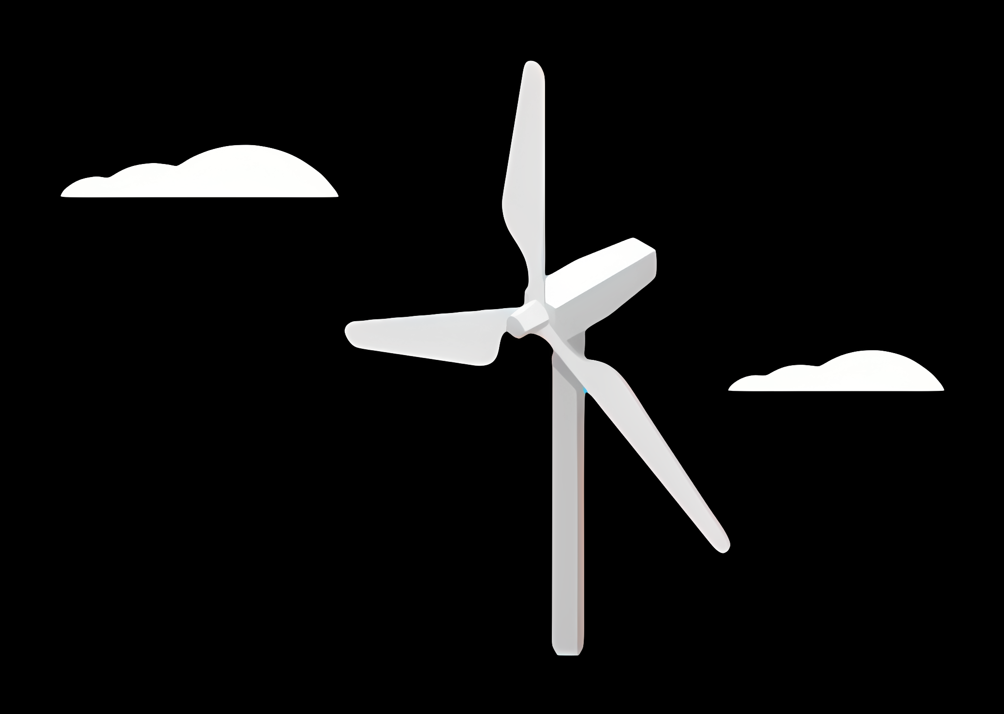
Weekly Report: Rotor Blade Structures
Week: 01
Date: 23/09/2025
Supervisor: Prof. Dr. Laurence Alhrshy
Group members: Bhima Masare, Dongsuk Kim, Anudeep Allanki, Mithun Shetty

Slide 2
Steps Planned during the Project Phase –
Define Blade Geometry
Material Selection
Structural Layout & Component Design
Finite Element Modelling
Load Analysis & Simulation
Performance Verification & Optimization
Reference –
5 MW/61.5m Wind Turbine Blade Reference Model by Brian R. Resor, Sandia National Laboratories, California, USA

Slide 3
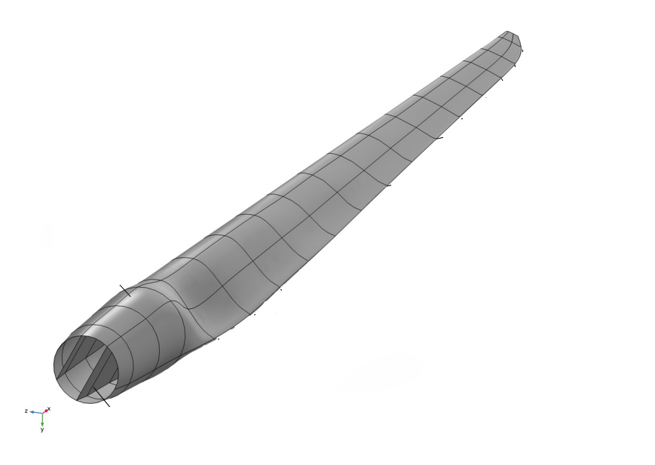
Step 1 - Define Blade Geometry
Use existing models (i.e. Brian Resor 5MW/61.5m, NREL 5MW) as reference models
Incorporate Air foil shapes, chord distribution, and blade length with help of Team Blade Aerodynamics
Adjust tip and root geometries considering structural requirements from other Teams
Ensure compatibility with manufacturing constraints with the current Industrial Standards

Slide 4
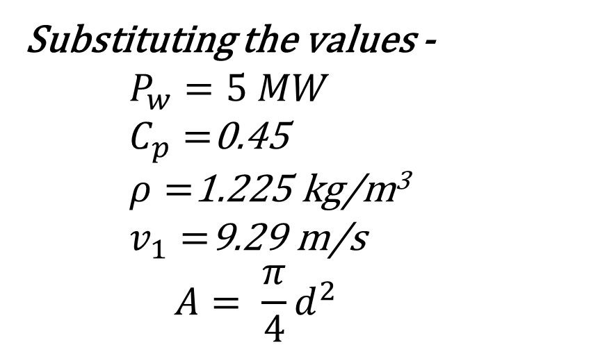
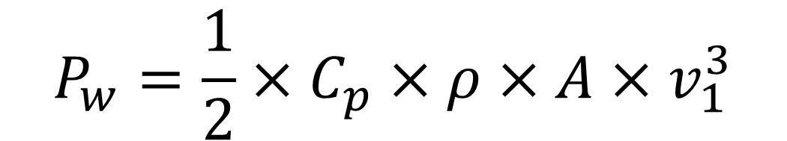
Step 1 - Define Blade Geometry
$$P_{w}=\frac{1}{2}×C_{p}×ρ×A×v_{1}^{3}$$
Substituting the values -
$$P_{w}=5 MW$$
$C_{p}=$0.45
$ρ=$1.225 kg/m³
$v_{1}=$9.29 m/s
$$A= \frac{π}{4}d^{2}$$
We get –
D = 170 m
R = 85 m

Slide 5
Step 1 - Define Blade Geometry
Cylinder 1 - inboard root cylinder (no lift, Cd ≈ 0.50) (blade nodes 1–2)
Cylinder 2 - inner cylinder (no lift, Cd ≈ 0.35) (node 3)
DU40_A17 - (node 4)
DU35_A17 - (nodes 5–6)
DU30_A17 - (node 7)
DU25_A17 - (nodes 8–9)
DU21_A17 - (nodes 10–11)
NACA64_A17 - (nodes 12–17, tip region)

Slide 6
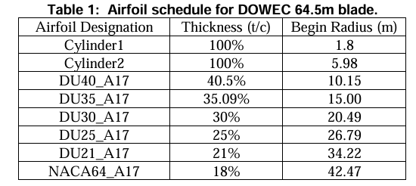
Step 1 - Define Blade Geometry
Source - Definition of a 5 MW/61.5m Wind Turbine Blade Reference Model by Brian R. Resor

Slide 7
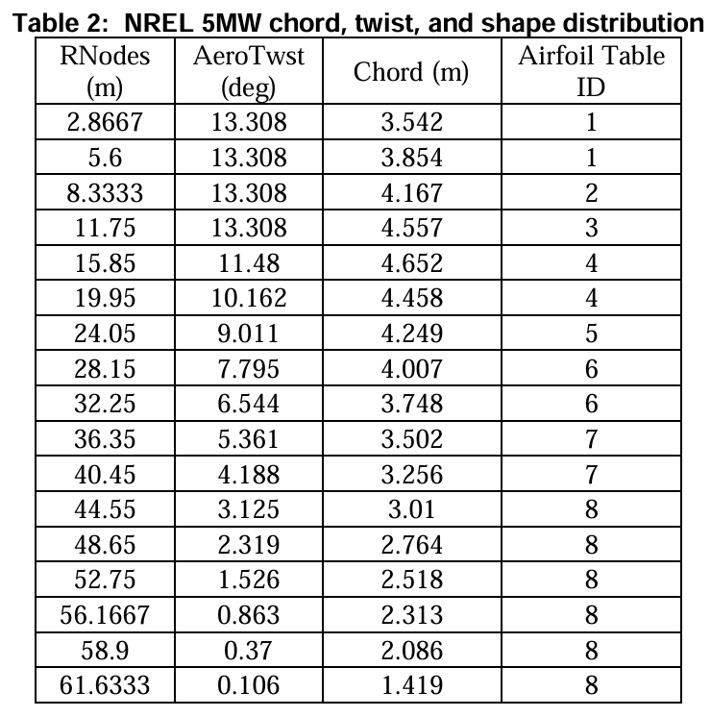
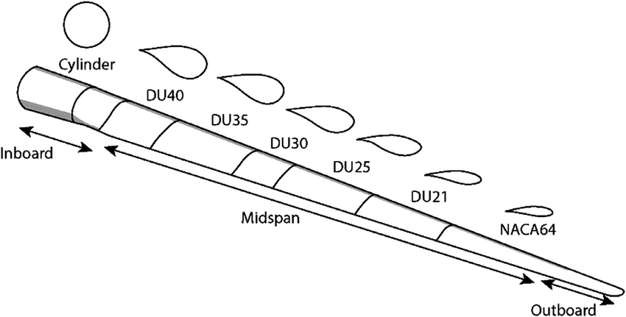
Step 1 - Define Blade Geometry
Source - Definition of a 5 MW/61.5m Wind Turbine Blade Reference Model by Brian R. Resor

Slide 8
Bibliography
Definition of a 5 MW/61.5m Wind Turbine Blade Reference Model by Brian R. Resor, Sandia National Laboratories, California, USA
Definition of a 5 MW Reference Wind Turbine for Offshore System Development, J. Jonkman, S. Butterfield, W. Musial, and G. Scott, National Renewable Energy Laboratory, USA

